Slide 1
Lab 2
Yao zhao，wwy

Slide 2
Lab2.A
https://lms.sustech.cloud/cs208/25s/assignment

Slide 3
Input：
Tree：
16 5
mkdir a
echo 123 > a/b
echo 234 > a/c
echo 345 > a/d
mkdir b
mkdir c
mkdir d
echo 666 > b/a
echo 23333 > c/a
echo 12312dasdasdf > d/a
mkdir a/e
echo > a/e/b
echo > b/b
echo > d/b
rm a/c
rm -rf a/e
cat d/a
cat c/a
find
find a -name b
find ././././ -name b -type f
.
├── a
│ ├── b
│ └── d
├── b
│ ├── a
│ └── b
├── c
│ └── a
└── d
├── a
└── b

Slide 4
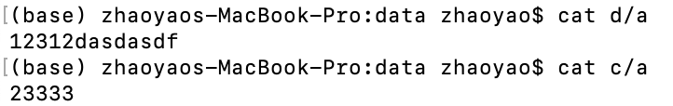
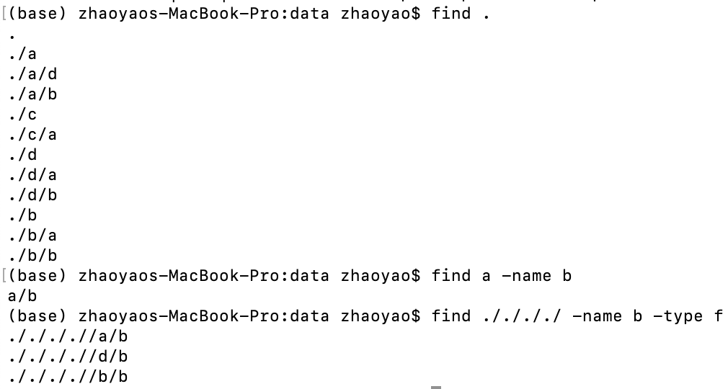

Slide 5
Lab2.B
Given an undirected connected graph G with n nodes and m edges. Nodes are numbered starting from 1 to n .
Given two integers a, b . Now counting the pairs (x, y) that any path from node x to node y goes through node a and node b (x ≠ a, x ≠ b, y ≠ a, y ≠ b) .
Print the required number of pairs. The order of two nodes in a pair does not matter, that is, the pairs (x, y) and (y, x) must be taken into account only once.

Slide 6
Input：
7 7 3 5
5 6
6 7
7 5
1 2
2 3
3 4
4 5
2
1
6
7
3
4
5
Pairs:
(1, 6) (2, 6)
(1, 7) (2, 7)
Output：
4

Slide 7
bonus 0.2
hand write the DFS code and indicate at which different positions the output would produce pre-order, in-order, and post-order traversal results.
The method of checking will be conducted through in-class inspections this and next week.

